Slide 1
Chapter 11. The Laplace Transform in Circuit
Analysis

Slide 2
Contents
Basic Conceptions
Low-Pass Filters (LPF)
High-Pass Filters (HPF)
Band-Pass Filters (BPF)
Band-Reject Filters (BRF)

Slide 3
Objectives of Chapter 9
By this chapter, you should:
  Know the conception of transfer function, passband, stopband, decibel, cutoff frequency, center frequency, bandwidth (BW), and Q-factor;
  Know the RL and RC circuits that act as low-pass filter, high-pass filter;
  Know the RLC circuits that act as band-pass filter and band-reject filter;
  Understand the conception of resonance.

Slide 4
9-1 Basic Conceptions
Transfer function
Decibel
Frequency selective circuit (Filter)
Passband and stopband

Slide 5
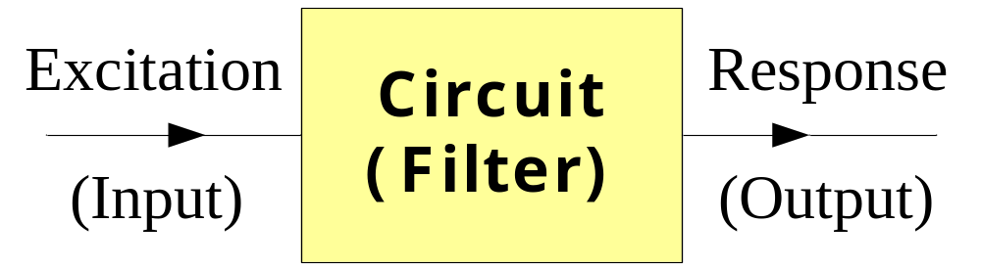
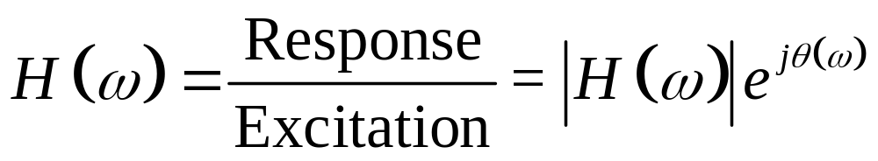
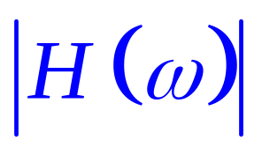
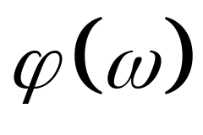
Basic Conception of Transfer Function
Transfer Function:
:Magnitude of transfer function
:Phase angle of transfer function

Slide 6
Basic Conceptions for Filter
A frequency selective circuit (or filter), enables signals at certain frequencies to reach the output, and it attenuates signal at other frequencies to prevent them from reaching the output.
The passband contains the frequencies of those signals that are passed.
The stopband contains the frequencies of those signals that are attenuated.

Slide 7
9-2 Low-Pass Filter (LPF)
RL Low-Pass Filter
RC Low-Pass Filter

Slide 8
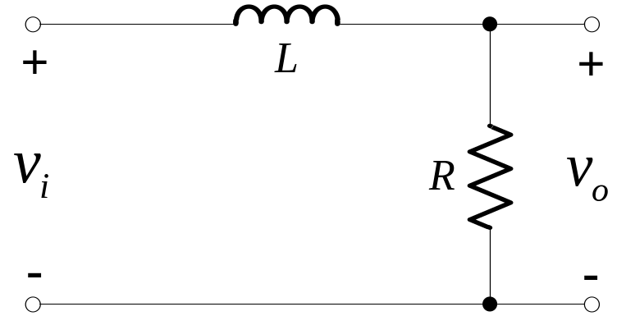
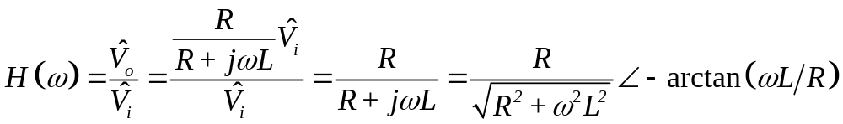
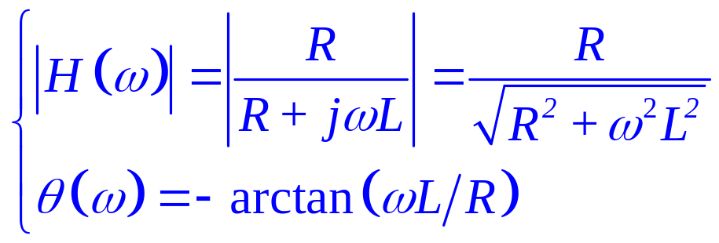
Low-Pass Filter (RL)
Transfer Function:

Slide 9
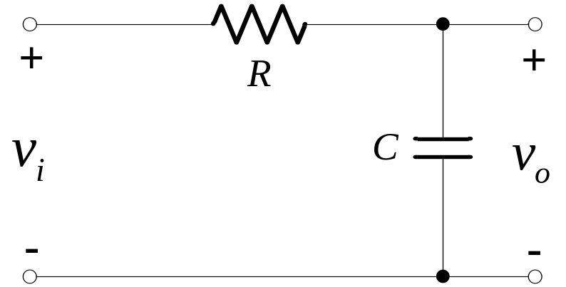
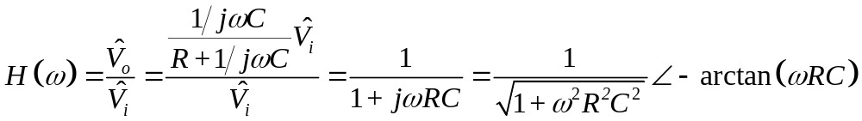
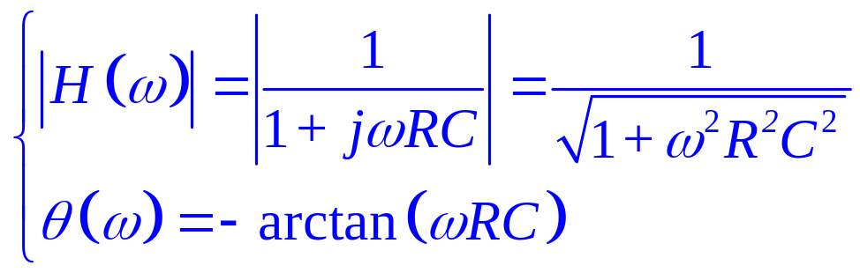
Low-Pass Filter (RC)
Transfer Function:

Slide 10
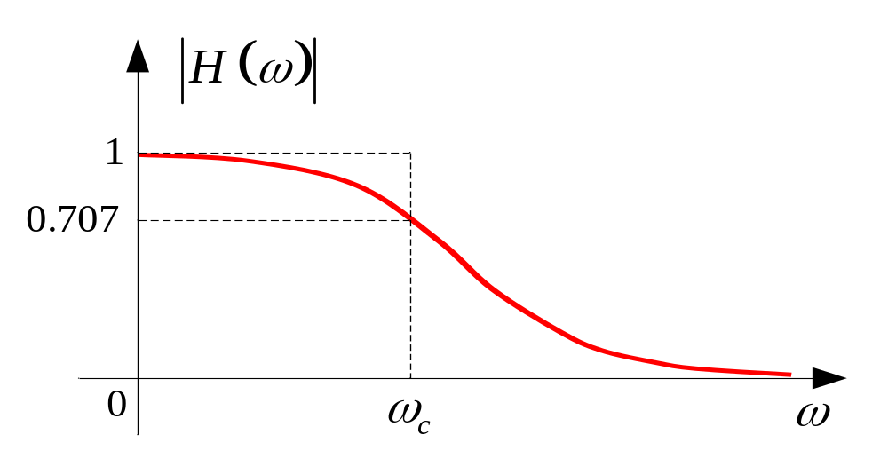
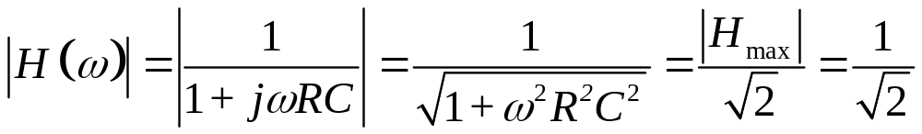
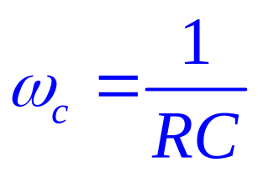
Low-Pass Filter (RC)
Cutoff Frequency
Pass band

Slide 11
9-3 High-Pass Filter
RC High-Pass Filter
RL High-Pass Filter

Slide 12
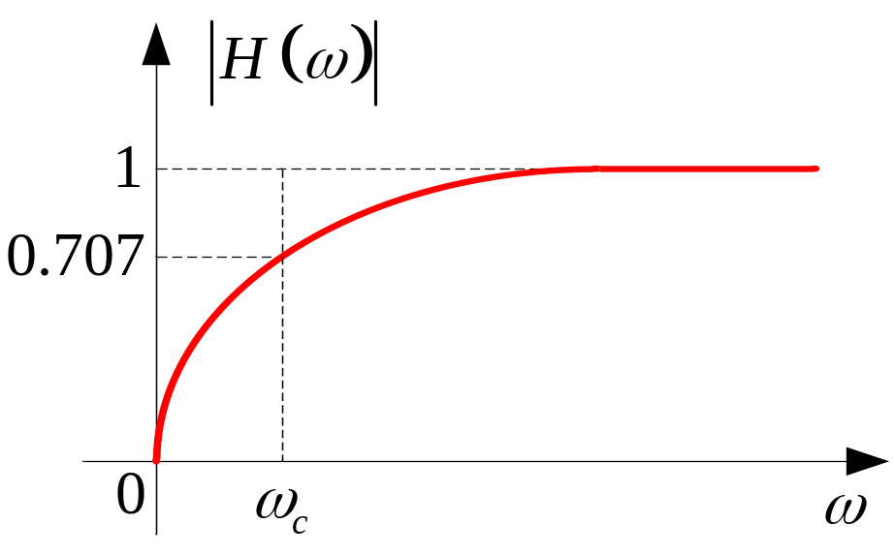
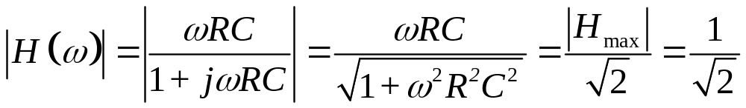
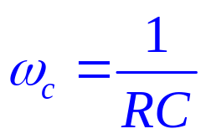
High-Pass Filter (RC)
Pass band
Cutoff Frequency
A high-pass filter passes voltages at frequencies above ω_{c} and attenuates voltages at frequencies below ω_{c} .

Slide 13
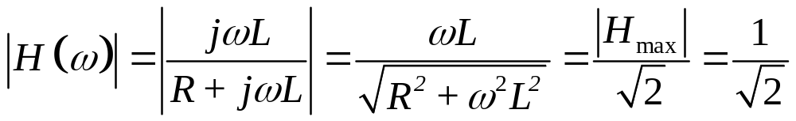
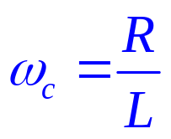
High-Pass Filter (RL)
Pass band
Cutoff Frequency

Slide 14
9-4 Band-Pass Filter
Bandpass filters (bandreject filters) has two cutoff frequencies, ω_{c1} and ω_{c2}.
These filters are further characterized by their center frequency (ω₀), bandwidth (BW), and quality factor (Q-factor).
A band-pass filter passes voltages at frequencies within the pass-band, which is between ω_{c1} and ω_{c2} ; and it attenuates frequencies outside of the pass-band.

Slide 15
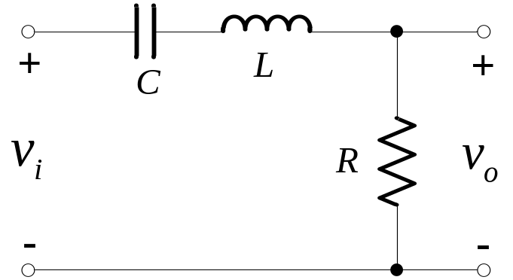
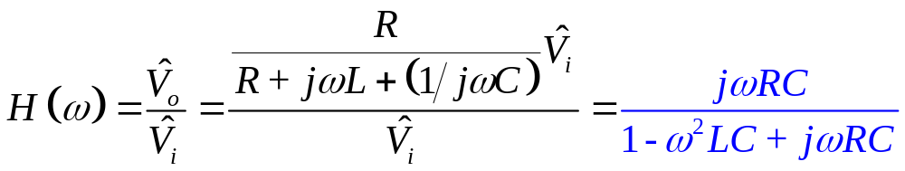
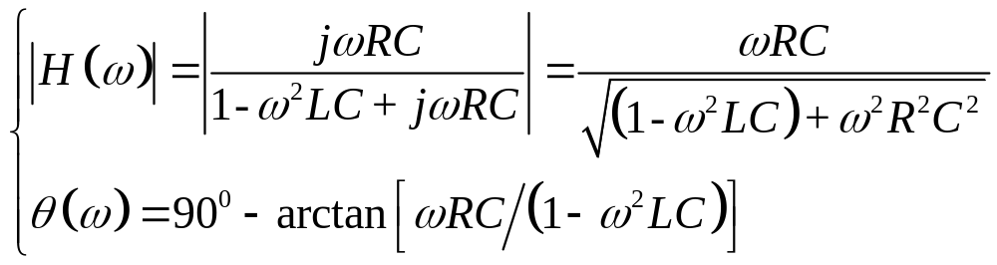
Band-Pass Filter
Transfer Function:

Slide 16
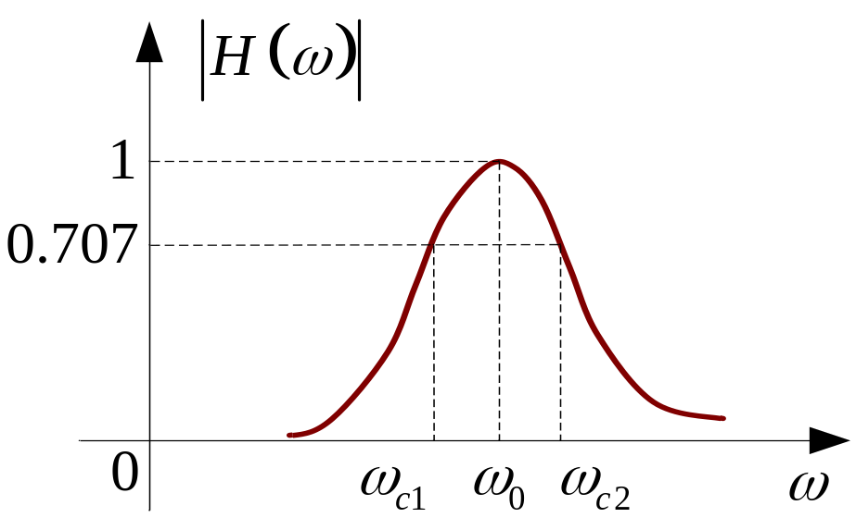
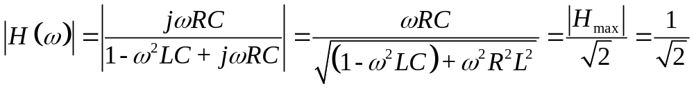
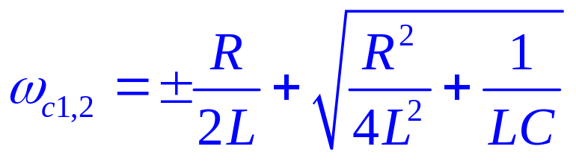
Cutoff Frequency of BPF
Upper Cutoff Frequency
Lower Cutoff Frequency

Slide 17
9-5 Band-Reject Filter
A band-reject filter attenuates voltages at frequencies within the stop-band, which is between ω_{c1} and ω_{c2} .
It passes frequencies outside of the stop-band.

Slide 18
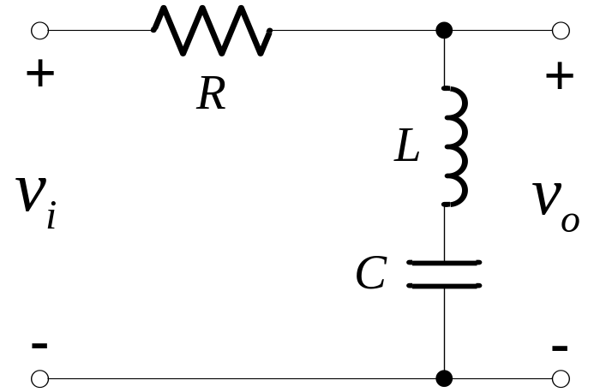
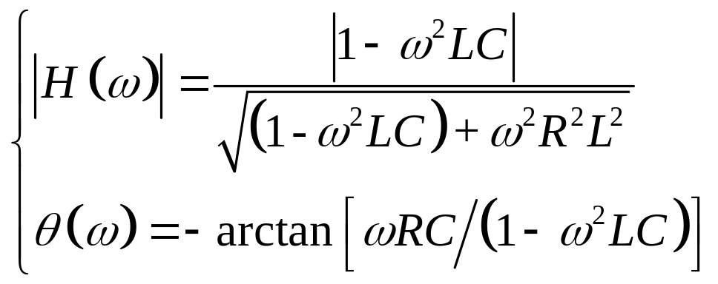
Band-Reject Filter
Transfer Function magnitude and phase angle:

Slide 19
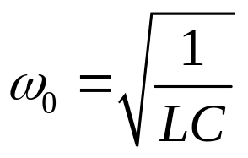
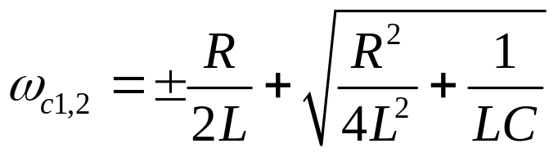
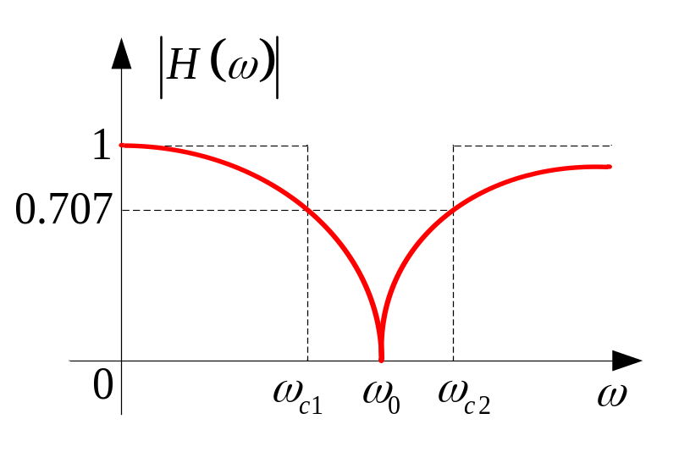
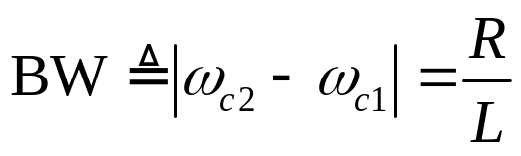
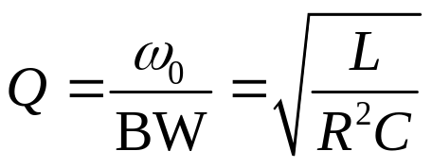
Band-Reject Filter
Center Frequency:
Cutoff Frequency:
Bandwidth:
Q-factor:

